Slide 1
Should Big Mountain Change it’s Ticket Price?
Jonathan Isaac

Slide 2
The Question
A cursory look at the pricing of our competitors brought us to this research question: Should Big Mountain change it’s ticket price?
A major motivation for this research is that extra revenue is required to make up for the recent addition of a chair lift
The goal is to find the correct actions to take to make back the $1.5 million increase in operating costs
Price change, cost cutting, and expansion actions were tested to see which combination of these would increase revenue most

Slide 3
Results and Key Findings
After finding and testing the best model, we can recommend a $5 ticket price increase
Additionally, we found that we can cut the least popular run and save the operating costs
Finally we saw a good expansion option to be adding a run with to increase vertical height dropped by 150 ft

Slide 4
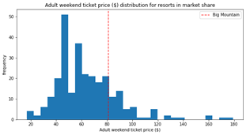
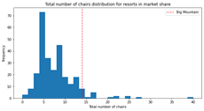
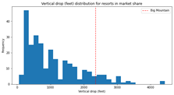
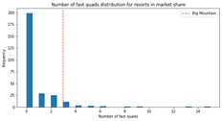
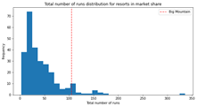
Price Change
Our Model identified the most important factors contributing to Ticket Price in the data, and Big Mountain is ahead of the competition in almost all of them. Yet, as pictured in the left graph of ticket prices, Big mountain is close to the average. The recommended change is below the model’s suggested price change of $15.

Slide 5
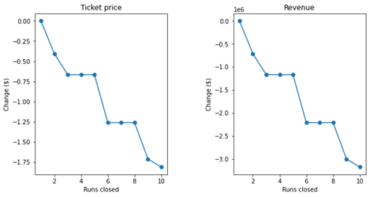
Cutting the Least Popular Run
We allowed our model to evaluate the scenario where we cut up to 10 of our runs.
As you can see, the model predicts that cutting a single run does not affect revenue. This shows that continuing to support our least popular run is a cost without any benefit.

Slide 6
Adding a Run
The data finds that the addition of new run that increases total vertical height by 150 ft would allow us to increase our price by another $8.61. Over a single season, assuming average attendance, this would constitute an increase in revenue of around $15 million.
As long as the operating costs of this new run can stay under this number, this new run will pay for itself in a few seasons.
We also tested expanding the snowfall land, but this did not result in a significant increase in revenue to offset it’s cost.

Slide 7
Conclusions
Here the random forest model for pricing that we created gives us three suggested actions, here in order of risk:
Closing our least popular run
Increasing our price by $5 to bring us closer to the market pricing
Adding a new run increasing vertical height drop by 150 ft

